Slide 1
K-means and Hierarchical Clustering Data Science Assignment 4
February 16, 2022
Daksh Patel

Slide 2
K-means Clustering
Create subgroup in a manner that each data point belongs to only one group and try to keep maximum distance between clusters.
1 - Decide number of clusters (Elbow Method)
2 - Initialize random centroids and divide data points in cluster with corresponding closest centroid.
3 - Keep iterating in a manner that centroids get closer to the data points and stop when there is no change in position of centroid.

Slide 3
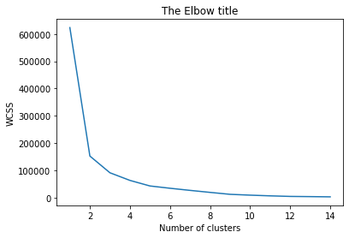
Elbow Method
Starting with 1 cluster , we find the distance between 2 farthest data points in single cluster and plot on graph.
we increase the number of clusters and compute same for all clusters.
That will give us graph like shown here, looks like a human hand.
The point where we find the elbow point is optimal value for number of clusters.

Slide 4
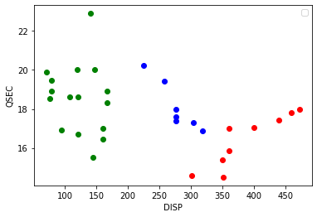
Libraries Output
pandas
numpy
matplotlib
sklearn.cluster

Slide 5
Hierarchical Clustering
2 closest points are usually in one group, hierarchical cluster follow this logic.
Make a pair of 2 closest data points and put them in same cluster,find closest clusters and combine them until left with only one cluster.
Dendrogram is used for visual representation of the clusters.

Slide 6
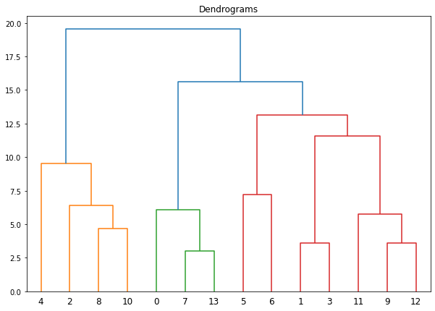
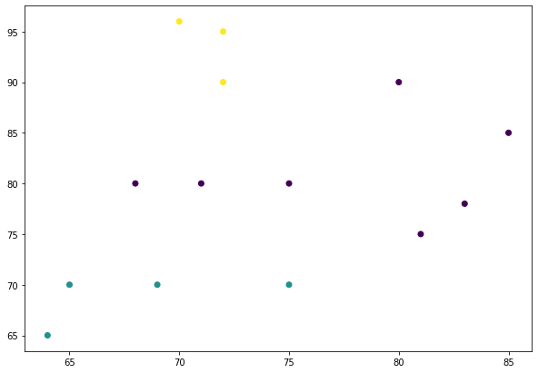
Libraries Output
pandas
numpy
matplotlib
scipy

Slide 7
Thank You

